Slide 1
Safety Improvements on
Existing Roads
Lars.Ekman@trafikverket.se

Slide 2
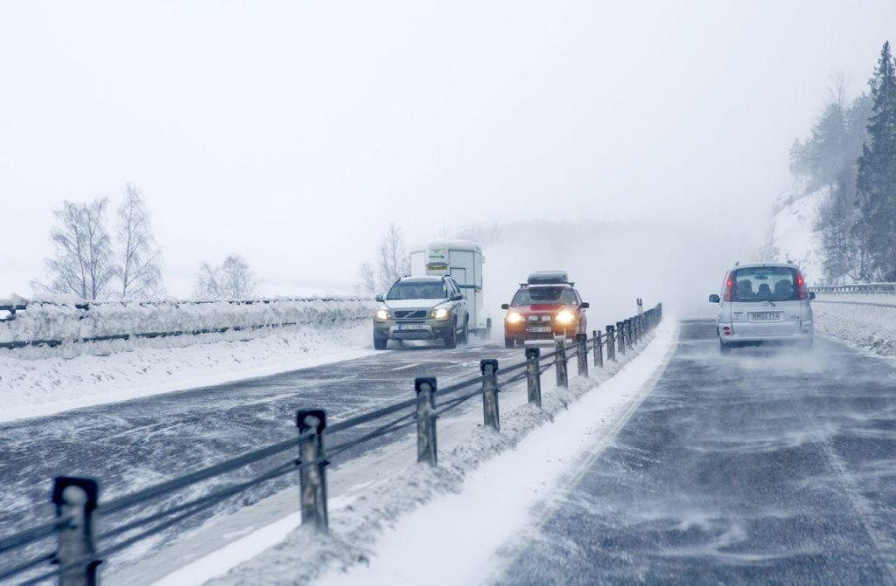

Slide 3
Outline
We have plenty of roads, but few new
Safety problem to solve
Roads without mid-barrier
Even the good roads need improvements

Slide 4
0,2%
Notes:
Fraction that is new anually

Slide 5
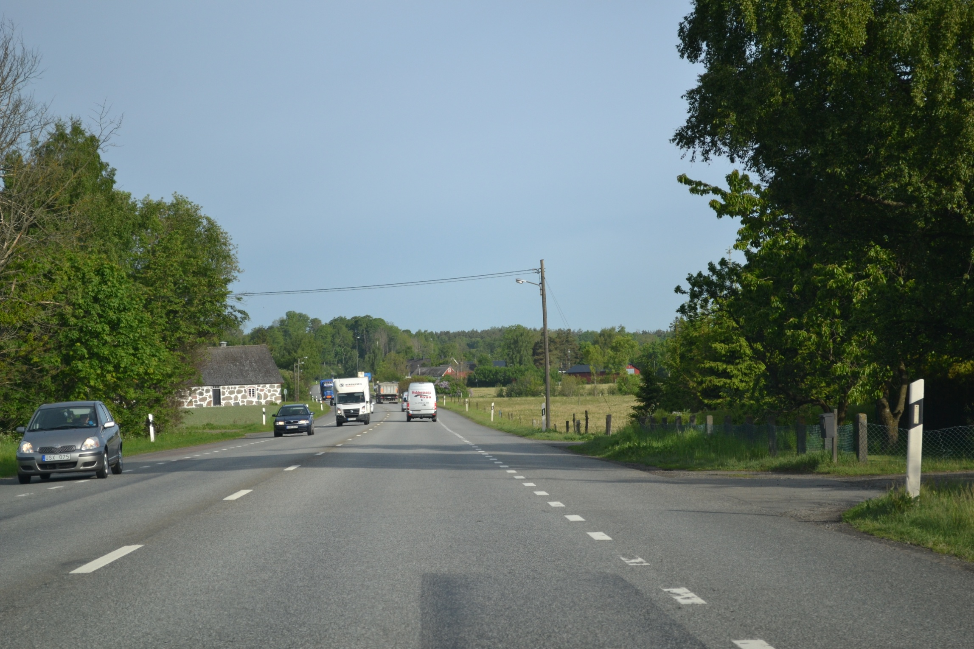

Slide 6
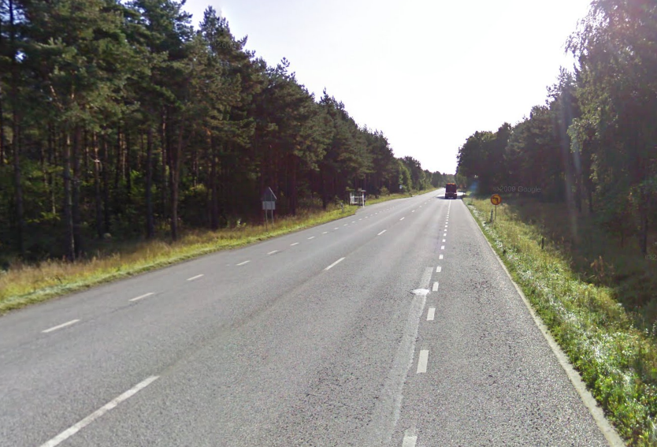
Ru 3
Ru 2
Ru 1

Slide 7
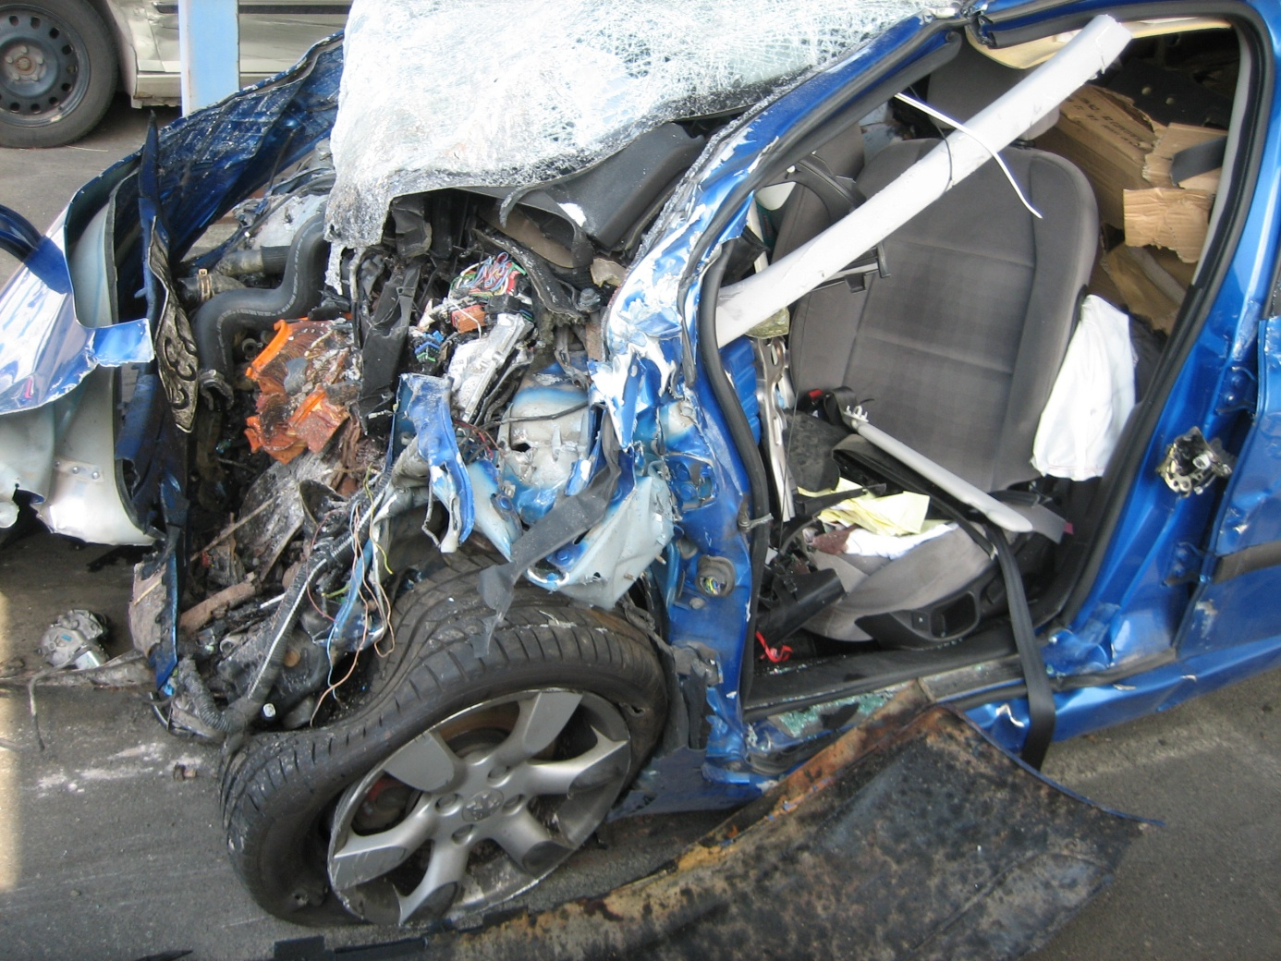

Slide 8
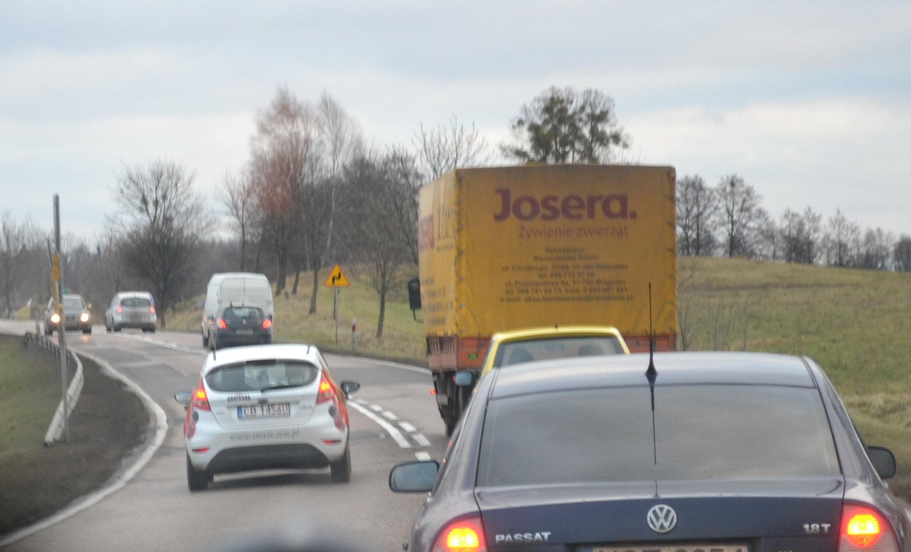

Slide 9
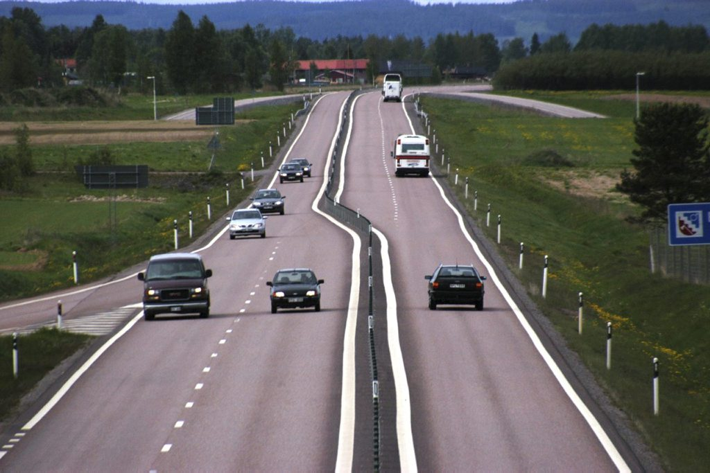

Slide 10
In Sweden we have build a lot of 2+1 roads

Slide 11
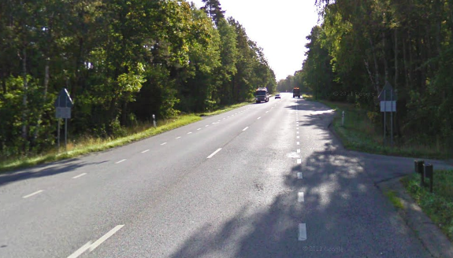
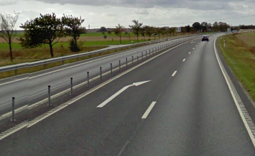
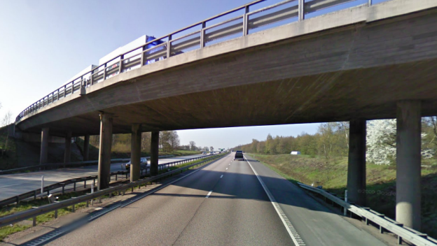
90 km/h roads
Risk
Motorway (C)
Motorway (A)
Two lane, wide
Two lane, narrow
Two lane, normal
2+1
2+1

Slide 12
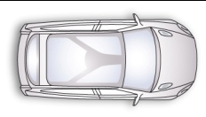
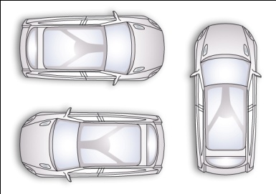
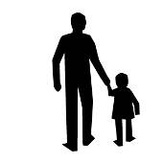

Division of Responsibilities
Example of common view on the division of responsibilities.
Passive Active
60
+ + + + +
20
80
Head-on
Below this speed: vehicle responsible. Above this speed: infrastructure responsible.
40
Pedestrians
10
30
70
Side
55
15
+
Rear-end
20
20
40
20
20
40
110
Large
animals
80
30

Slide 13
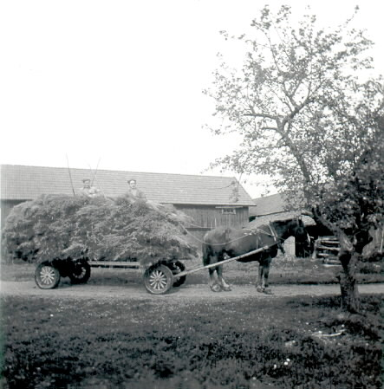
The vehicle of the future - Just like the farmer’s horse:
Can be steered actively and in full control by the farmer but
It can handle a situation where the farmer falls asleep and still find its way home and
It will not accept being steered into a tree or off a cliff

Slide 14
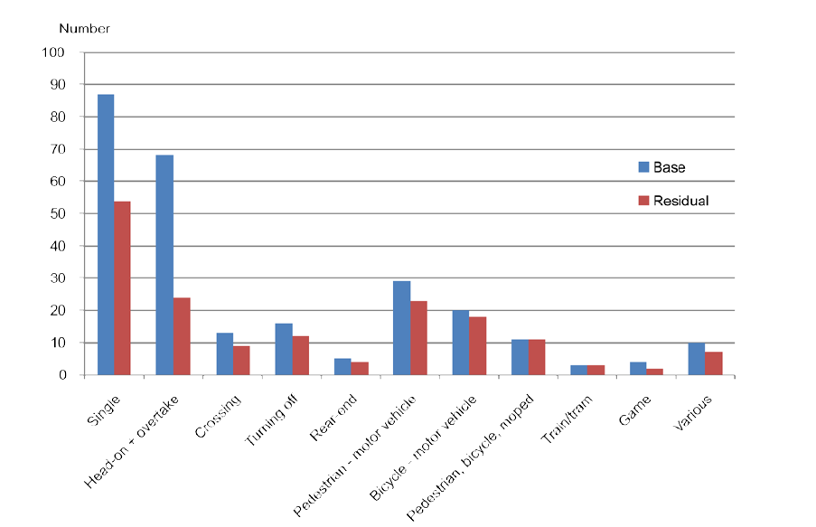
Figure 4.4. Prediction for fatalities in 2020 by type of accident based on projection of vehicle and infrastructure technology trends. Source: In-depth studies of fatal accidents.

Slide 15
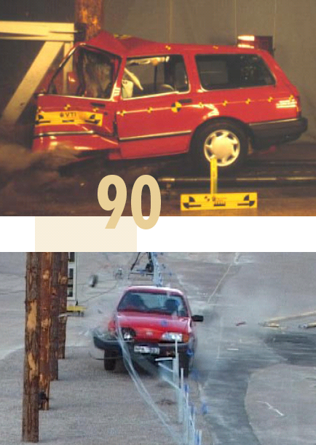
Speed limit, road design and car design goes hand in hand!
Crash test 90km/h into tree
Crash test 90km/h into guard rail
Notes:
two

Slide 16
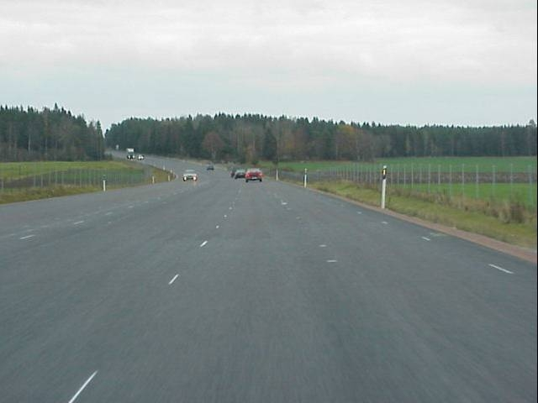
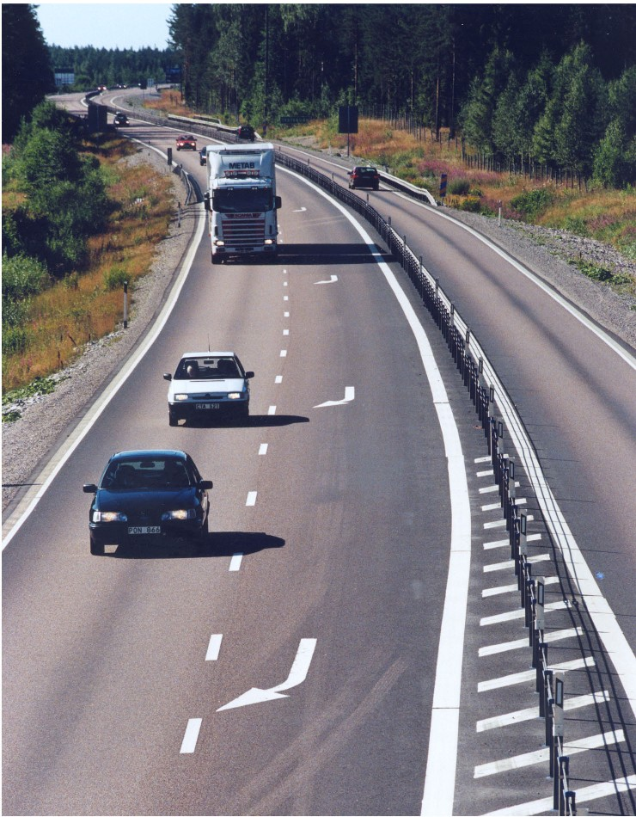
Controlling on-coming traffic

Slide 17
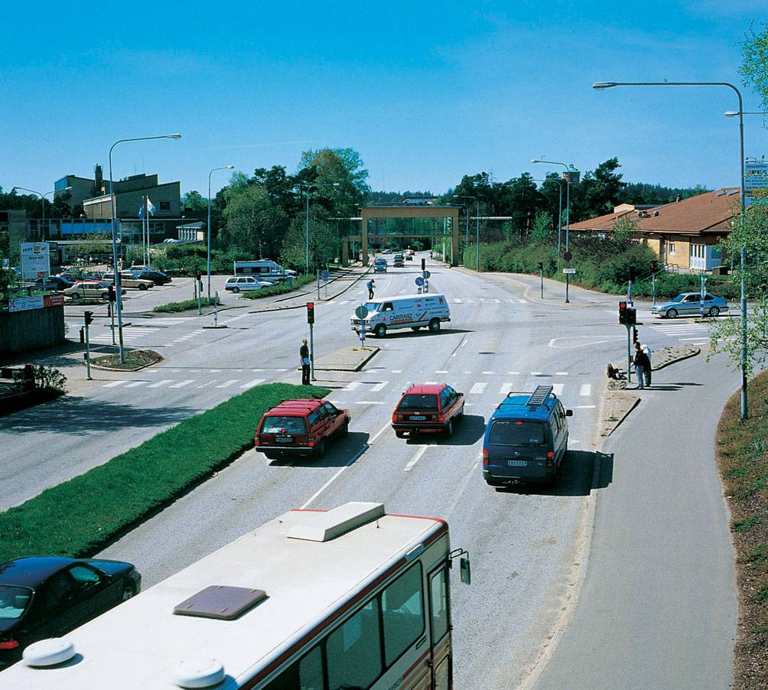
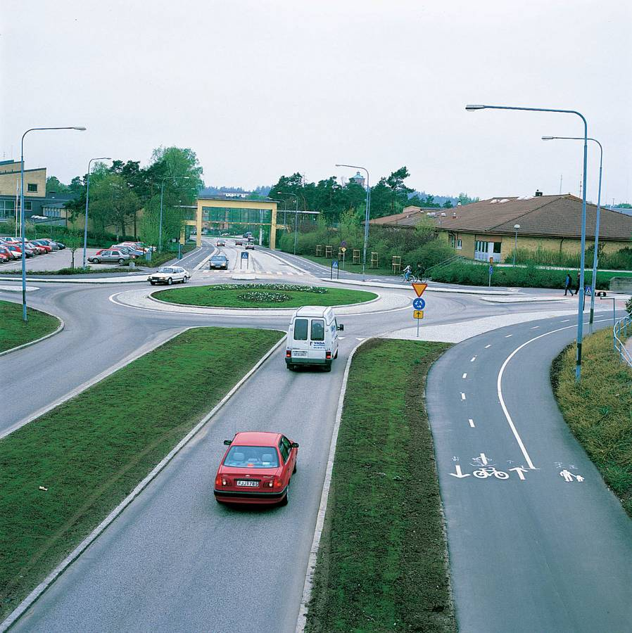
Intersections to roundabouts

Slide 18
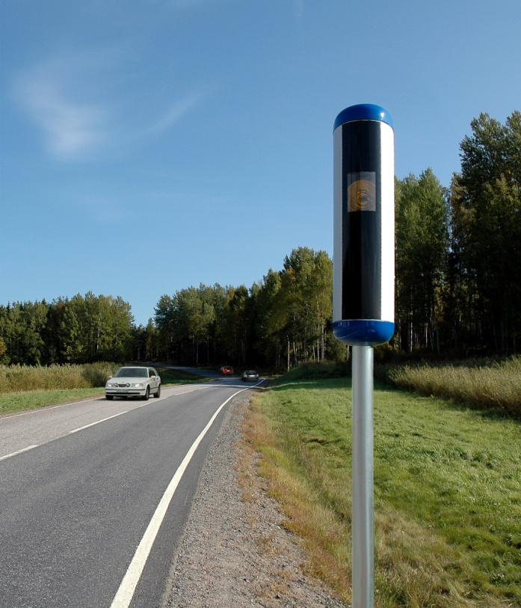
A modern camera system

Slide 19
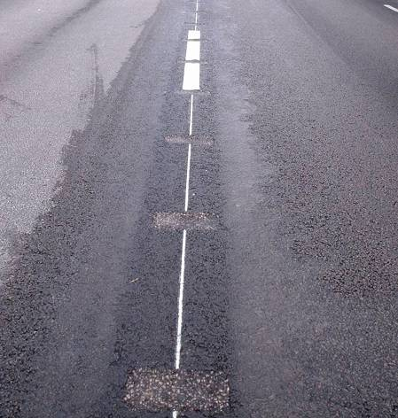
Rumbling centerline

Slide 20
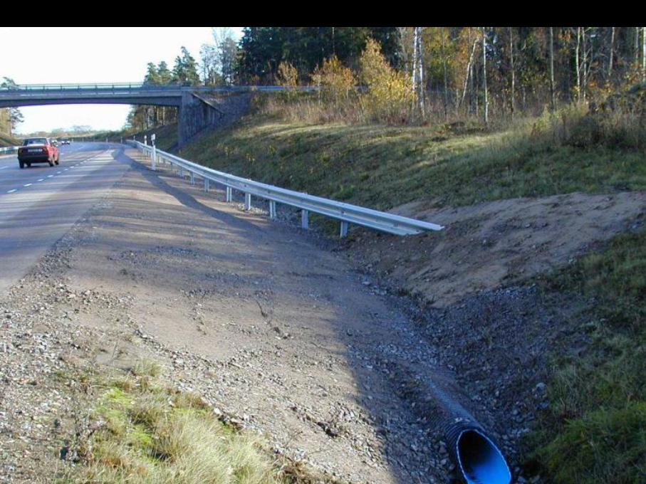

Slide 21
Conclusion
We have plenty of roads, but few new
Speed manageable for the humans
Roads with mid-barrier and safe sides can have high speed
Even relative good roads need improvements
Countermeasures that meet the problem with serious injury

